Slide 1
Module 5.5 Repeated measures designs

Slide 2
What is a “repeated measure”?
Repeated observations made on individual units (e.g., subjects, plots), either
sequentially through time
Treatment structure that is applied sequentially through time

Slide 3


What is a “repeated measure”?
Repeated observations made on individual units (e.g., subjects, plots), either
sequentially through time
Treatment structure that is applied sequentially through time
PRE
POST

Slide 4
What is a “repeated measure”?
Repeated observations made on individual units (e.g., subjects, plots), either
sequentially through time
Treatment structure that is applied sequentially through time
Time 1
Time 2
Time 3

Slide 5

What is a “repeated measure”?
Repeated observations made on individual units (e.g., subjects, plots), either
sequentially through time
Treatment structure that is applied sequentially through time
Spring
Summer
Fall

Slide 6
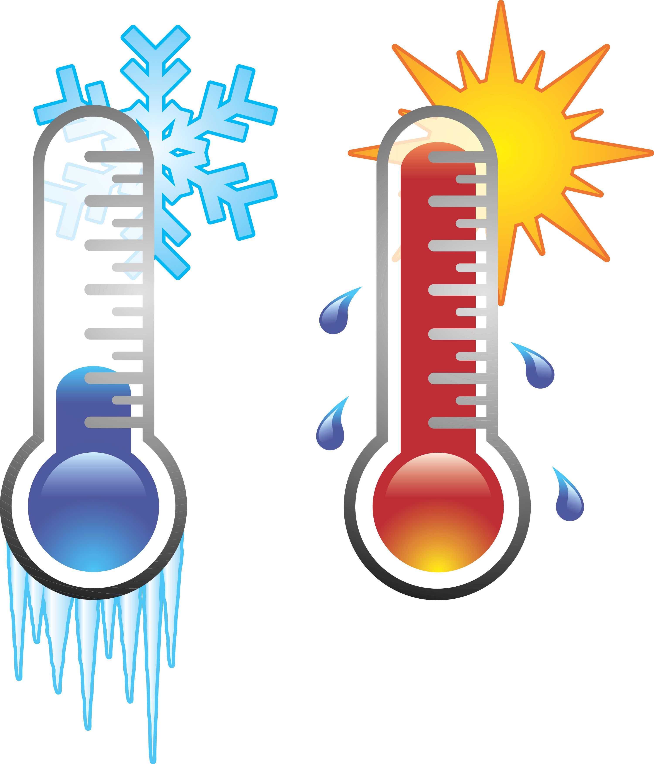

What is a “repeated measure”?
Repeated observations made on individual units (e.g., subjects, plots), either
sequentially through time
Treatment structure that is applied sequentially through time

Slide 7
What is a “repeated measure”?
Repeated observations made on individual units (e.g., subjects, plots), either
sequentially through time
Treatment structure that is applied sequentially through time

Slide 8
How to account for repeated measures?
Just like Block designs or split-plot designs
The “repeated” treatment of time is always the smallest plot

Slide 9
How to account for repeated measures?
Just like Block designs or split-plot designs
The “repeated” treatment of time is always the smallest plot
Example 1: Measures of insect respiration rate at five timepoints on 10 individual insects
Example 2: Monthly measurements of plant regrowth after fire

Slide 10


How to account for repeated measures?
Just like Block designs or split-plot designs
The “repeated” treatment of time is always the smallest plot
Example 1: Measures of insect respiration rate at three timepoints on five individual insects in two temperature treatments
5 x 3 x 2 = 30 data points
How many independent reps of temp?
1, 2, 3
1, 2, 3
1, 2, 3
1, 2, 3
1, 2, 3
1, 2, 3
1, 2, 3
1, 2, 3
1, 2, 3
1, 2, 3

Slide 11
Example of repeated measures of plant regrowth after fire – Example 2
Time 1
Time 2
Burned
Unburned

Slide 12
Example of repeated measures of plant regrowth after fire – Example 2
1,2
Burned
1,2
1,2
1,2
1,2
1,2
Unburned
1,2
1,2

Slide 13
Accounting for temporal autocorrelation
Autocorrelation occurs when measurements taken close together in time are correlated
Usually positive but can be negative
More likely to occur with many measurements taken fairly close together in time
ie. time series analysis
>2 measurements (ideally more)
Need to account by specifying an appropriate correlation structure in your random effects
Most common is autoregressive correlation structure (AR1)
Similar techniques can be used for spatial autocorrelation

Slide 14
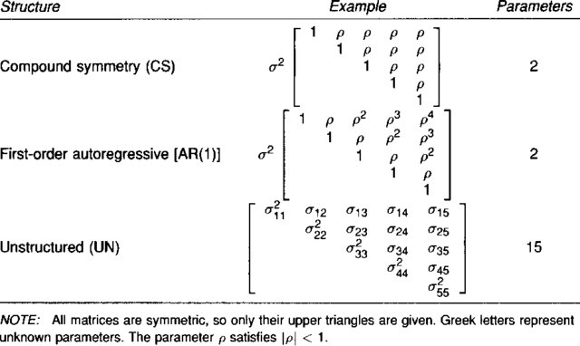
Accounting for temporal autocorrelation
ρ = correlation coefficient
σ = covariance
Time points should be roughly evenly spaced.
Very flexible, but complex!
Toeplitz is another commonly used structure; in between AR1 and UN.
Better accounts for unevenly spaced sampling.
Wolfinger 1996

Slide 15
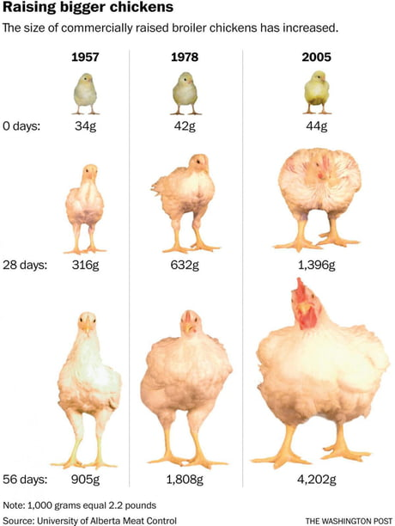
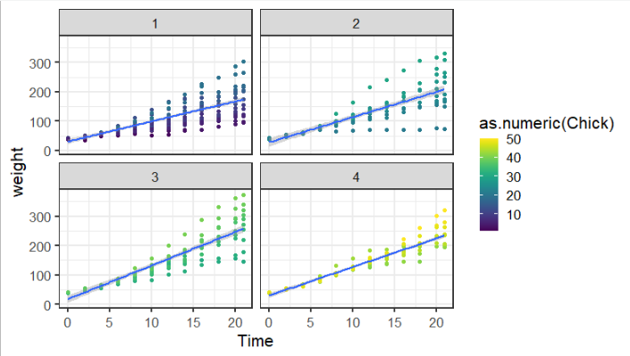
ChickWeight example

Slide 16
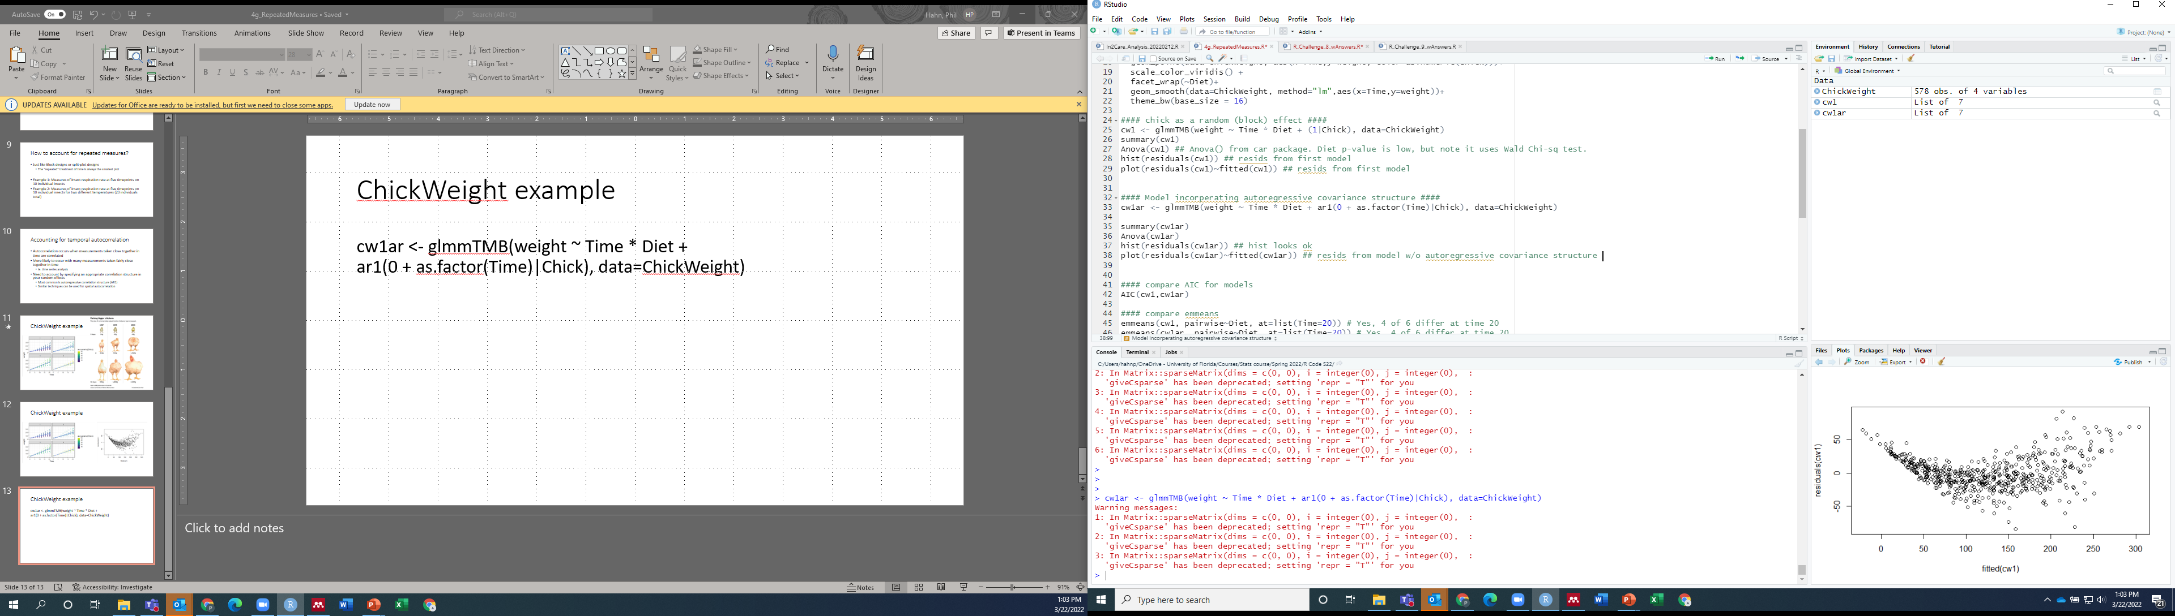
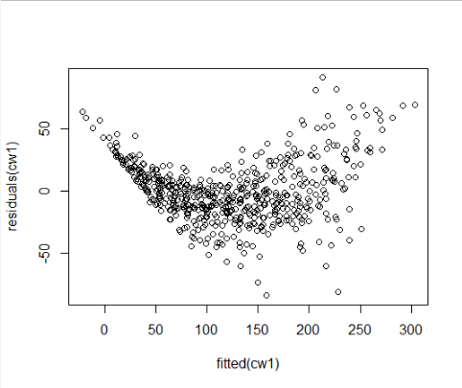
ChickWeight example – blocking term only
Random effect

Slide 17
ChickWeight example – account for autocorr
Random effect
Sets autoregressive correlation structure
Chick as block
(ie. what is being repeatedly measured)
Specifies correlations across timepoints

Slide 18
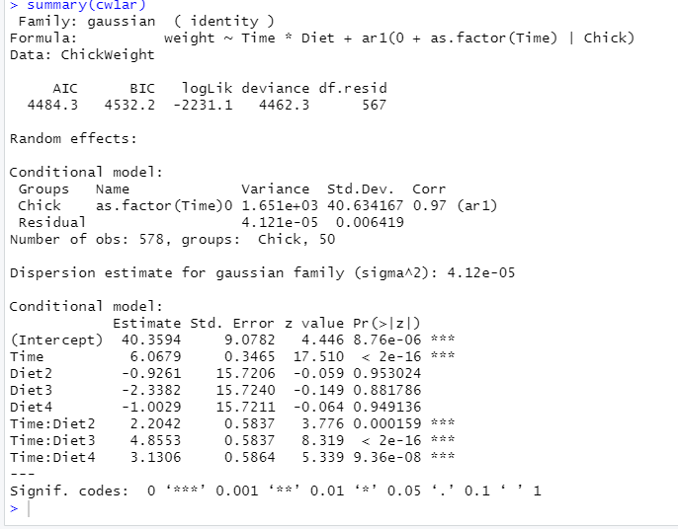
ChickWeight example – account for autocorr
Random effect
VC and ar1 (temporal autocorrelation coefficient)

Slide 19
ChickWeight example
ρ = 0.97
What should the correlation between Time 8 and Time 10 be? (one time point apart)
0.97
0.97² = 0.94
0.97³ = 0.91
0.97⁴ = 0.88
0.97⁵ = 0.85
What should the correlation between Time 8 and Time 12 be? (two points apart)
What should the correlation between Time 2 and Time 12 be? (five points apart)

Slide 20
ChickWeight example

Slide 21
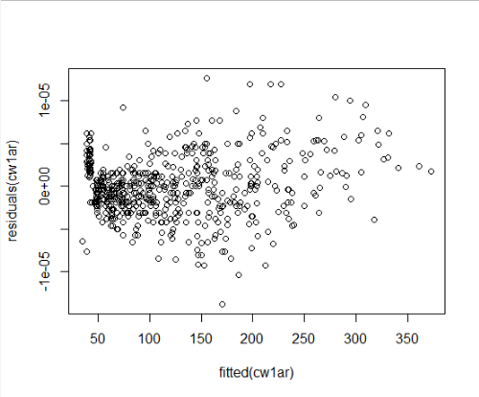
ChickWeight example
Random effect

Slide 22
ChickWeight example
Random effect
Model | df | AIC
cw1 | 10 | 5508
cw1ar | 11 | 4484

Slide 23
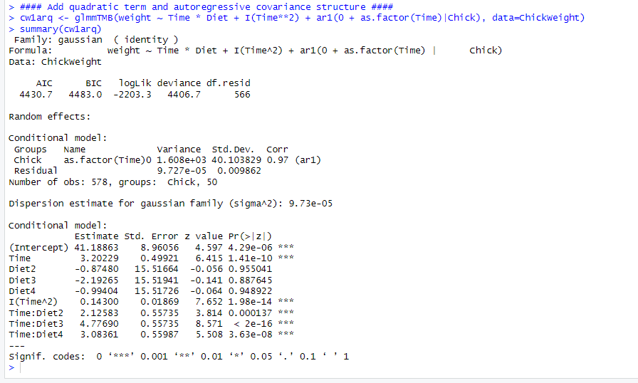
ChickWeight example – with quadratic term

Slide 24
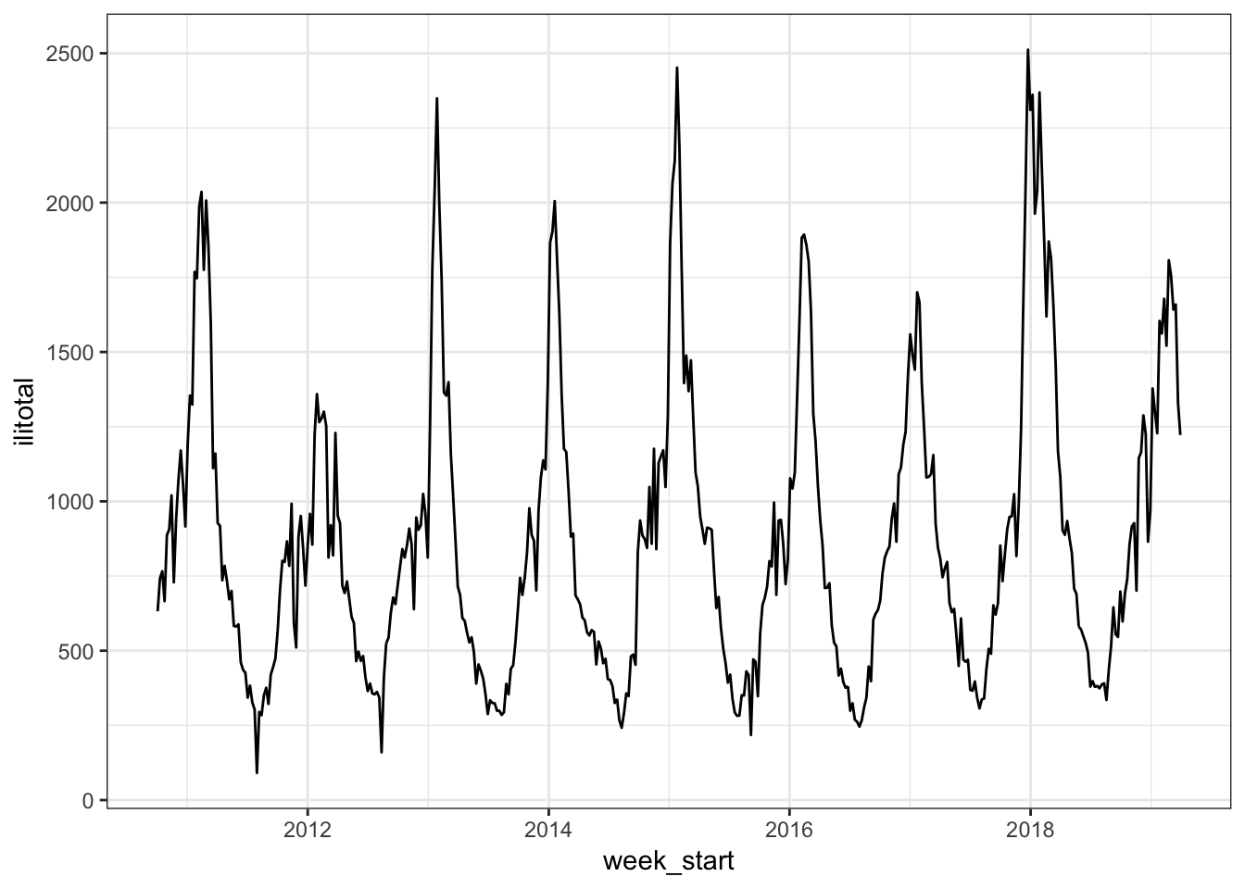
GAMs for more complex time series
Generalized additive models can be used to fit more complex time series data
Some Resources:
https://asbates.rbind.io/2019/05/03/gams-for-time-series/
Modelling seasonal data with GAMs
mgcv: Mixed GAM Computation Vehicle with Automatic Smoothness Estimation

Slide 25
Worked example of repeated measures
Harris water dataset
Water use and tree growth

